Slide 1

Program Name
Camper Orientation
Insert Logo – If you do not have a logo, delete this box

Slide 2
Program Goals

Slide 3
Program Goals
Consider the purpose of your program and what campers will take away from their experience (remove this line)
Purpose of the Program: Input the purpose of the program here.
Expected Learning Outcomes: Campers at [insert program name] can expect to [insert learning outcomes].

Slide 4
Camper Expectations

Slide 5
Check-in/Check-out
Input the program's check-in/check-out information here. Make sure to include the items below and detail the times/processes/locations for check-in and check-out. (remove this line)
Check-in:
Check-out:
Parents and guardians will need to provide a valid ID during drop-off/pick-up, except for campers who can self-check-in/check-out or campers who have permission to bus/bike/fly/drive

Slide 6
Dress Code
Appropriate vs. Inappropriate Attire: Explain to campers what is appropriate to wear at the program and what is not appropriate.
If your program provides lanyards/t-shirts to identify campers, please make a note that t-shirts/lanyards must be worn at all times.

Slide 7
Schedule
Insert the program schedule here

Slide 8
Facilities
Daytime Programs:
Facilities that will be used during the program
Overnight Programs:
Dorm/facility safety rules
Campers are responsible for any damages to the facility and/or dorm
Campers should leave the environment better than they found it

Slide 9
Supervision

Slide 10
Camper Supervision
Campers are supervised at all times
There is no unsupervised free time
This includes breakfast/lunch/dinner (if on campus: Trips to the Drag/store/etc., exploring campus, common areas in dormitories)
No wandering alone without supervision.
YPP Rule of Three: There should always be at least two (2) designated individuals for one (1) camper or at least two (2) campers with one (1) designated individual. (A camper should never be alone with a designated individual.)

Slide 11
Camper Supervision Continued
Headcounts: Campers will be counted when leaving and arriving at a destination.
Curfew: If the program is an overnight program, insert curfew rules here.
Campers under 11 are not permitted to use the restroom without supervision.
Add notes about locker room rules, field trip procedures (if applicable), etc.

Slide 12
Prohibited Conduct

Slide 13
Prohibited Conduct
Campers should not have contact with designated individuals outside the presence of others
Remember YPP Rule of Three (2 designated individuals to every 1 camper or 2 campers to every one designated individual)
Campers should not be meeting with designated individuals outside of times for program activities
Report any inappropriate activity to the camp director or any other staff member including but not limited to inapproriate touching, verbal abuse, and violence

Slide 14
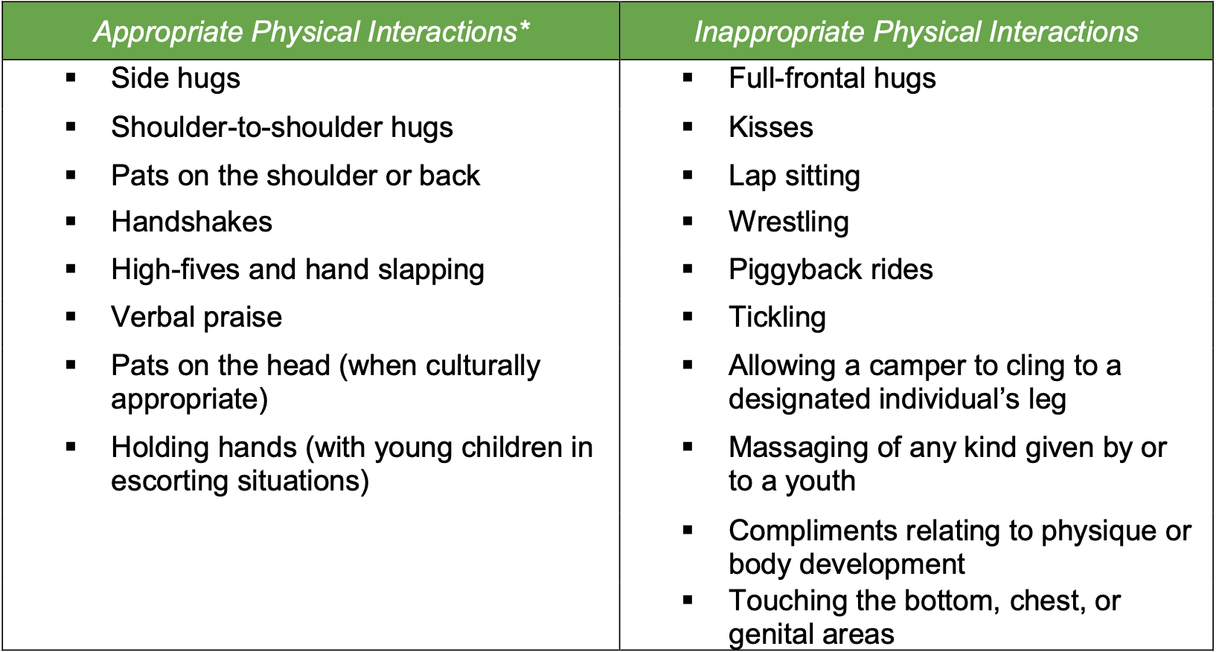
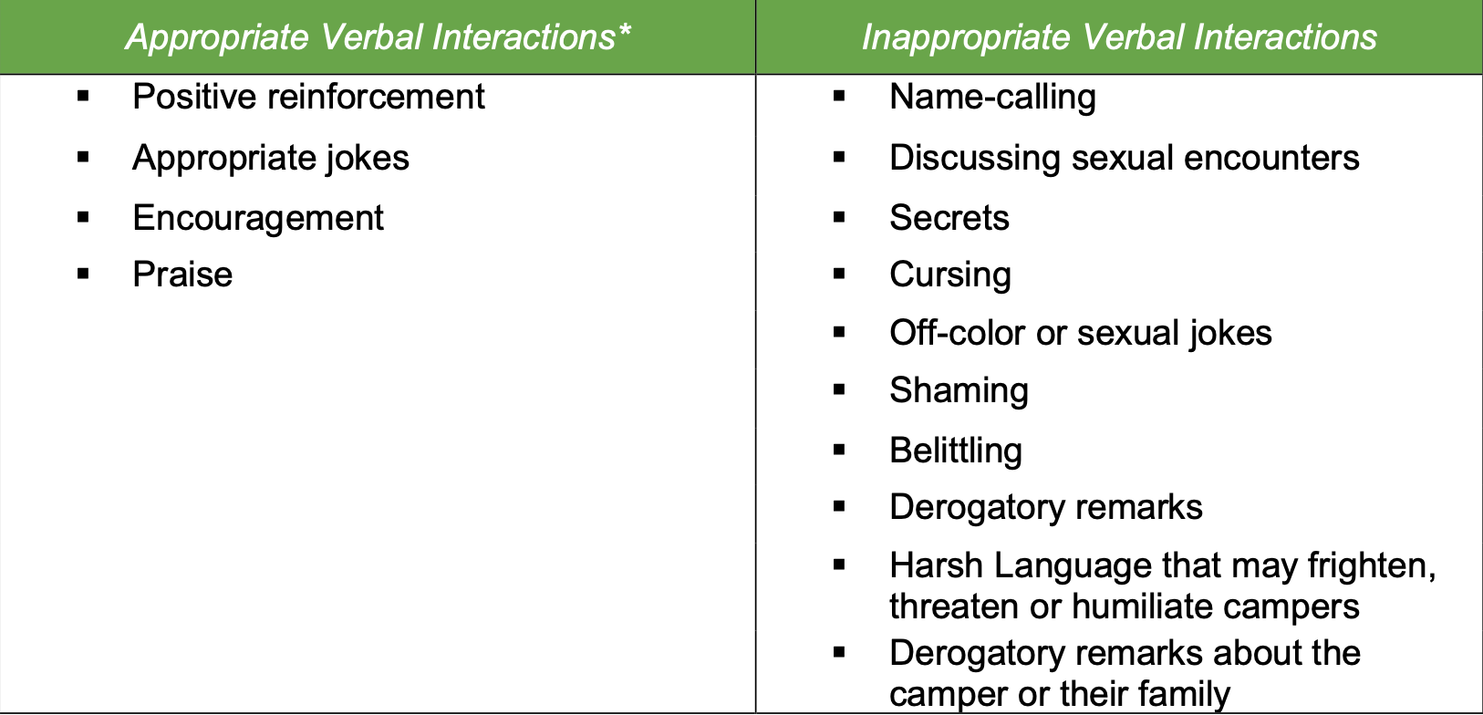
Prohibited Conduct Examples

Slide 15
Social Media Protocols
Designated individuals cannot friend/follow campers on social media
Campers cannot friend/follow designated individuals on social media
Designated individuals are only allowed to communicate through approved program social media accounts
Designated individuals cannot communicate with campers after the program has ended

Slide 16
Camper Behavior Management

Slide 17
Camp Code of Conduct
Insert camper code of conduct
Review it and explain the consequences of violations.
University YPP has a zero-tolerance policy for drugs, tobacco (including vaping), and alcohol.

Slide 18
Bullying
There is a zero tolerance for bullying!
Physical altercations will lead to being sent home, regardless of who started the fight.
Refer to Prohibited Conduct Examples (Slide 17)

Slide 19
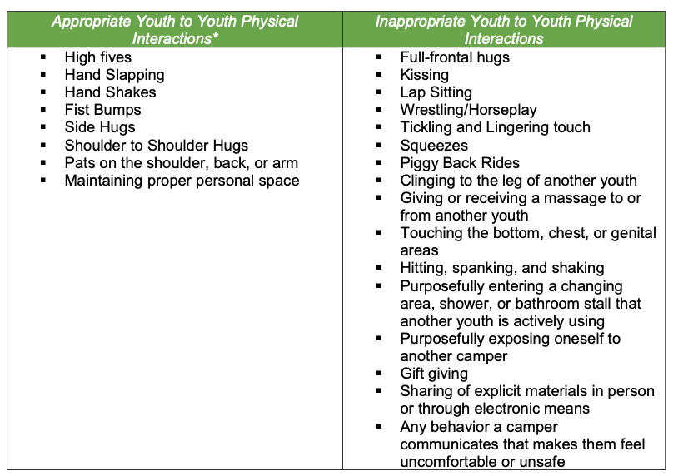
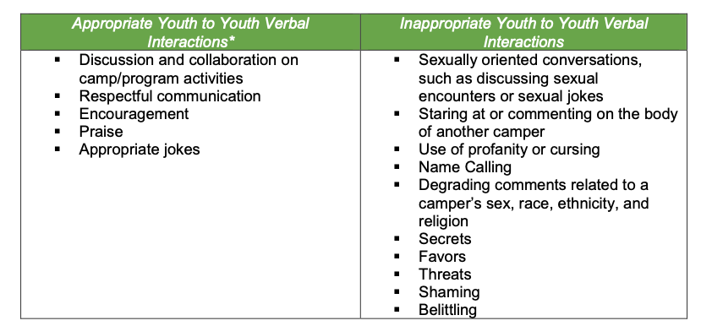
Prohibited Conduct Examples

Slide 20
Medication Policy

Slide 21
Medication
Only include if the program distributes medication.
Medication policy
Prescription and over-the-counter medication will be given to the camp director upon arrival.
Medication must be labeled and placed in a bag with the camper's name and instructions (dosage amount and times)
Medication must remain in the original container from the pharmacy
Medications must be stored and locked up
Two DIs are responsible for dispensing medications (should be named or pointed out)
The DIs will log activity in the medication log in Ideal Logic
Inhalers and EPI-Pens are allowed to stay with campers

Slide 22
Emergencies

Slide 23
YPP Program Emergency Plan
Practice the YPP-approved program emergency plan
Take campers to assembly areas, escape routes, and shelter for inclement weather/ evacuations.
Practice the program emergency plan from start to finish.

Slide 24
Missing/ Lost Camper
Explain procedures when a camper is missing/lost
Make sure all campers have emergency contact information for the program.

