Slide 1

Program Name
Designated Individual Orientation
Insert Logo – If you do not have a logo, delete this box

Slide 2
Program Goals

Slide 3
Program Goals
Consider the purpose of your program and what campers will take away from their experience (remove this line)​
Purpose of the Program: Input the purpose of the program here.​
Expected Learning Outcomes: Campers at [insert program name] can expect to [insert learning outcomes].​
Key Camp Contacts and Phone Numbers:​
[Insert important contact information here]​

Slide 4
Designated Individual Responsibilities

Slide 5
DI Role/Arrivals and Departures
Role: Explain what their role is in the program.
Arrival/Departure Times:
Designated individuals should arrive at [location] at [time] and depart at [time]
[insert the program's Time off policies]
[insert the program's Sick policies]
Parking:
Designated individuals will park at [insert garages or parking lots]
Include whether the or not the program provides parking vouchers

Slide 6
Camper Orientation
[Insert when/where the orientation will be held and a brief description about the content involved]

Slide 7
Check-in/Check-out
[insert the program's check-in/check-out policy and procedures here]
Designated individuals must verify the driver's license for parent drop-off/pick-up
If applicable, make sure to include information regarding Sign-in/Sign-out sheet for campers who can self-check-in/check-out; or those campers who have permission to bus/bike/fly/drive

Slide 8
Breaks and Lunch Breaks
Campers must still be supervised during breaks
[insert information here about the length of breaks and lunch breaks]

Slide 9
Dress Code
Appropriate Attire: [insert appropriate attire for the program]
Inappropriate Attire: [insert inappropriate attire for the program]

Slide 10
Designated Individual Duties
Designated individuals are responsible for ensuring the safety of each camper
Follow instructions of the camp director and execute or implement the program's supervision and instruction plan.
Monitor the behavior of campers to ensure that they adhere to the program's code of conduct
Enforce rules and immediately communicate any issues that occur to the camp director
Mandatory reporters/reporting: All camp directors and designated individuals must report to DFPS if they believe a child is being abused or neglected.

Slide 11
Designated Individual Duties
Utilize this slide to include any additional duties relevant to the program

Slide 12
Designated Individual Attitude
Maintain a professional demeanor at all times with campers
Have a cordial helpful, friendly attitude
Be aware of all prohibited conduct rules (presented in the next section)

Slide 13
Prohibited Conduct

Slide 14
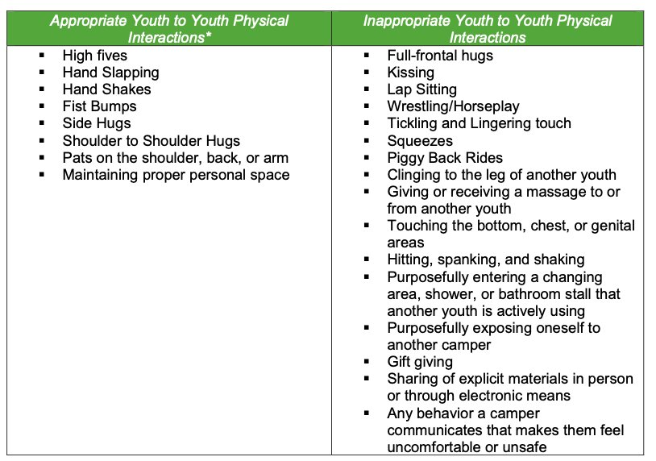
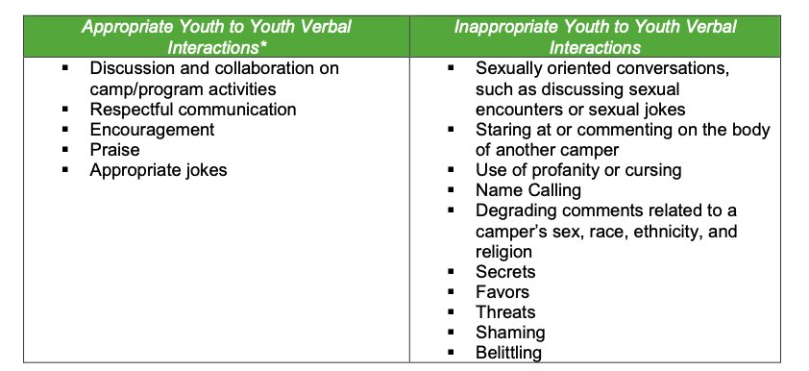
Prohibited Conduct
Please review all prohibited conduct information with the Designated Individuals.
Refer to the DI Guidebook pages 11-12
THERE IS A ZERO-TOLERANCE POLICY FOR DRUGS/ALCOHOL OR TOBACCO.

Slide 15
Social Media Protocols
All social media profiles must be set to private during the duration of the program
Do not friend/follow campers on social media
Campers cannot friend/follow designated individuals on social media
Designated individuals are only allowed to communicate through the program's social media group accounts
Do not communicate with campers after the program has ended

Slide 16
Media Protocols
Designated individuals are not allowed to take pictures or videos of campers on their personal cell phones
Programs must utilize a program cell phone or camera
Program photos may be posted on the program's text page
Designated individuals are not allowed to post pictures or videos on their personal social media accounts of any camper
The University of Texas at Austin does not cover designated individuals under the Media Consent Form

Slide 17
Supervision

Slide 18
Camper Supervision
YPP Rule of Three:
Campers should not be alone with a designated individual outside the presence of others
Two designated individuals to every one camper
Two campers to every one designated individual
There is no unsupervised free time
This includes breakfast/lunch/dinner breaks
If the program is on campus, this includes Trips to the Drag/Store/etc., exploring campus, common areas
Curfew:
[Insert curfew information here]

Slide 19
Camper Supervision
Restroom Breaks:
Ensure campers know where the restrooms are located
[Insert if campers are under the age of 11: Restroom breaks must be supervised. Campers under the age of 11 are not permitted to use the restroom without supervision]
[Insert if campers are over the age of 11: Campers over the age of 11 are permitted to use the restroom without supervision. However, after 5 minutes have passed, designated individuals should go to the restroom and check if the camper is okay.]
Traveling with Minors
Be mindful of pedestrian safety
Stay on sidewalks, use crosswalks, and look both ways when crossing the street
Designated individuals should be interspersed throughout the group to ensure campers are safe

Slide 20
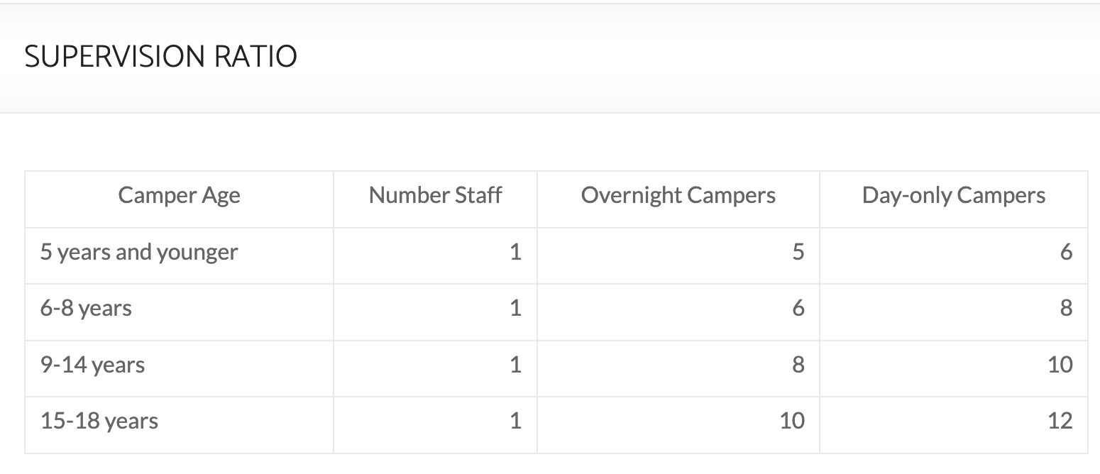
Headcounts
Headcounts:
When traveling from place to place, designated individuals should complete an initial headcount and another headcount upon arrival
Divide campers into small groups and use the buddy system
Ensure groups are within the approved ratios

Slide 21
See Something, Say Something!
Do not wait until something happens before saying something
Designated individuals should communicate with campers regularly. Tell the campers to communicate with you, the camp director, or the Youth Protection Program to report anything that makes them feel unsafe or uncomfortable
Camp directors should rehearse interrupting inappropriate behavior with designated individuals

Slide 22
Camper Behavior Management

Slide 23
Camper Code of Conduct
[Insert the camper code of conduct. Please feel free to utilize additional slides.]

Slide 24
Incident Forms
When is it appropriate to complete an incident report form?
All incidents of illness
Medical accidents/injury
Code of conduct violations
Suspected abuse and neglect to Department of Family and Protective Services
Reminder: All camp directors and designated individuals are mandatory reporters. They must report to DFPS if they believe a child is being abused or neglected.

Slide 25
Camper Behavioral Issues
When dealing with camper behavior adhere to the following guidelines:
Be fair
Give a verbal waning
Do not admonish the whole group
Mediate the conflict between campers
Be aware of boundaries and prohibited methods of discipline
Always be present
Positive reinforcement

Slide 26
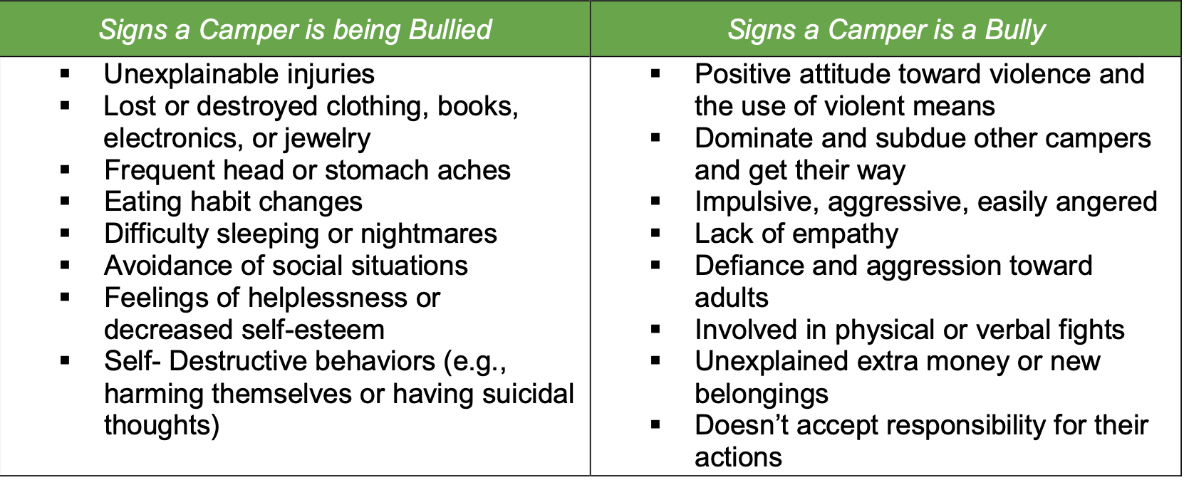
Bullying
Designated individuals should reiterate the following to campers:
Bullying is not acceptable and will not be tolerated
Ask a designated individual or camp director for help if a bully bothers you
Report bullying when you see and hear about it. Telling is not tattling.

Slide 27
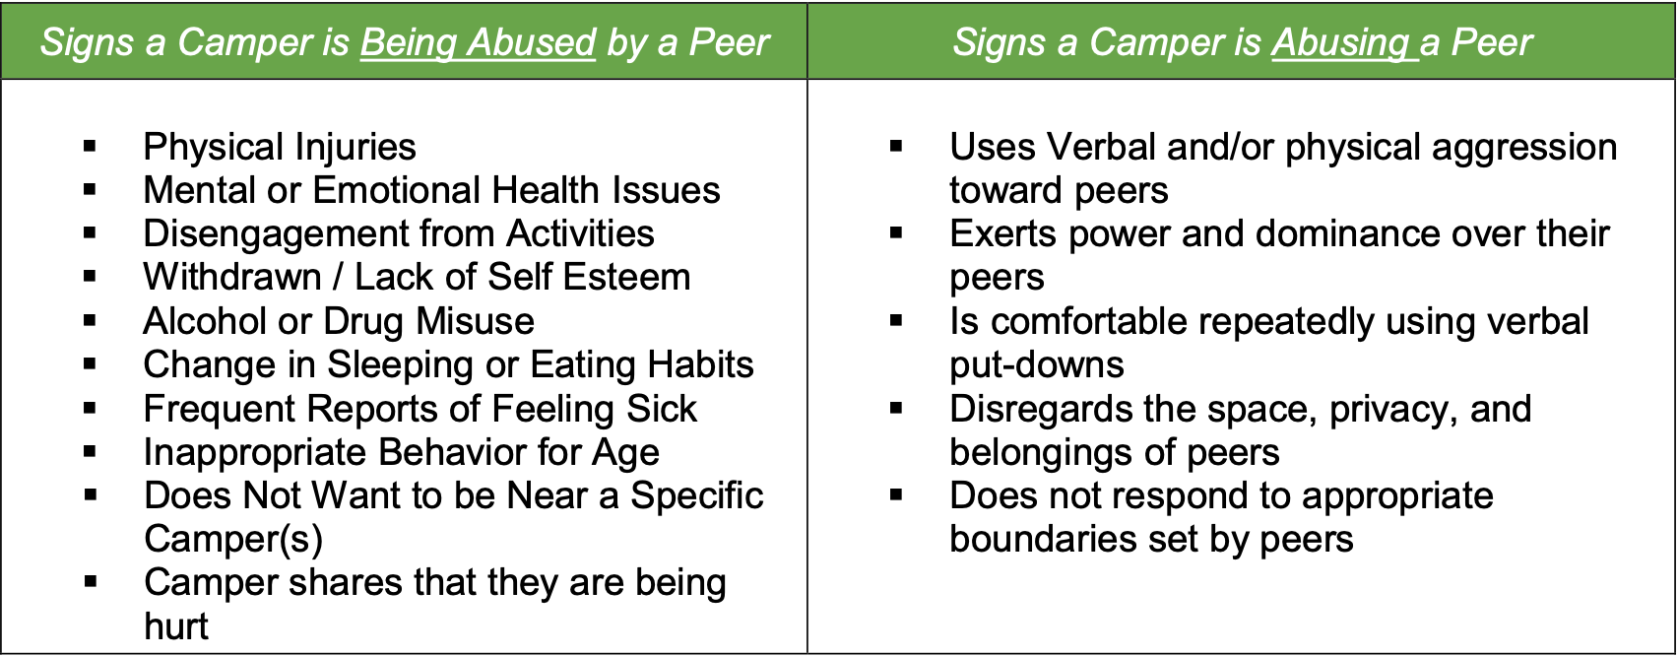
Peer-to-Peer Abuse Signs
Peer-to-peer abuse occurs when a child or youth (minor) is abused by another child/ren/youth (minor). The victim and the perpetrator can be of the same sex, different sex, same age, or differing ages.

Slide 28
Peer-to-Peer Abuse Prevention Guidelines
Remember that your role is supervision and not merely participating in activity for fun
Make sure that the ratio of staff to campers does not drop below the YPP ratio requirement even when someone should be called away or need to leave the site.
Position yourself in the best spot to supervise campers. You should be able to visually observe the campers and be able to listen to any verbal comments.

Slide 29
Medication Policy

Slide 30
Medication
Only include if program distributes medication (remove this line)
Medication policy
Prescription and over the counter medication will be given to camp director upon arrival.
Medication should be labeled and placed in a bag with camper's name and instructions (dosage amount and times)
Medication must remain in original container from the pharmacy
Medications must be stored and locked up
Two counselors are responsible for dispensing medications (should be named or pointed out)
Inhalers and epi-pens are allowed to stay with students

Slide 31
Emergencies

Slide 32
Emergency Plan
Practice the YPP-approved Program Emergency Plan
[Insert the YPP-approved Program Emergency Plan here]
Be sure to include information about emergency response tasks, emergency alarm device (how many times it will be sounded), assembly areas, fire escape routes, and shelter in place for inclement weather

Slide 33
Emergency Plan
During an emergency, remain calm and maintain order:
Think safety first
Account for all campers
The first-aid kit is located [insert location]
[Insert which designated individuals can administer first-aid/CPR/AED]
Calling 911, UTPD, or take a camper to UHS (or other medical facility):
[Insert when to do so]
Designated individuals cannot transport minors in their personal vehicle
The camp director and at least 1 designated individual must remain with the camper at the hospital or urgent care.

Slide 34
Missing/Lost Camper Procedure
Practice the missing/lost camper procedure:
[Insert the program's missing/lost camper procedure here]
General Guidelines:
Designated individuals must account for campers at all times
Regularly check attendance/specifically when campers are in transition
Immediately notify the camp director if a camper is unaccounted for
The camp director and designated individuals will immediately search the area where the camper was last seen.
If the camper is not located, take the following actions
The camp director will call UTPD and wait for them to arrive
The camp director will contact the parents
The camp director will contact the YPP Office
Camp directors and designated individuals will continue searching until the police arrive

